Slide 1
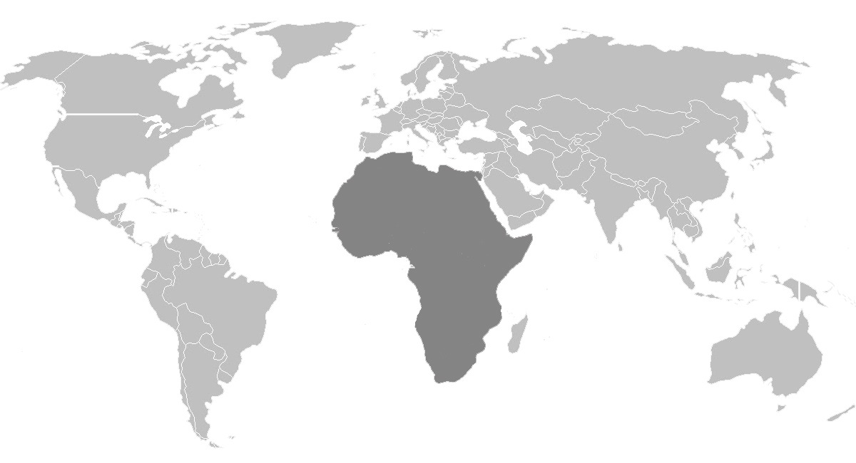
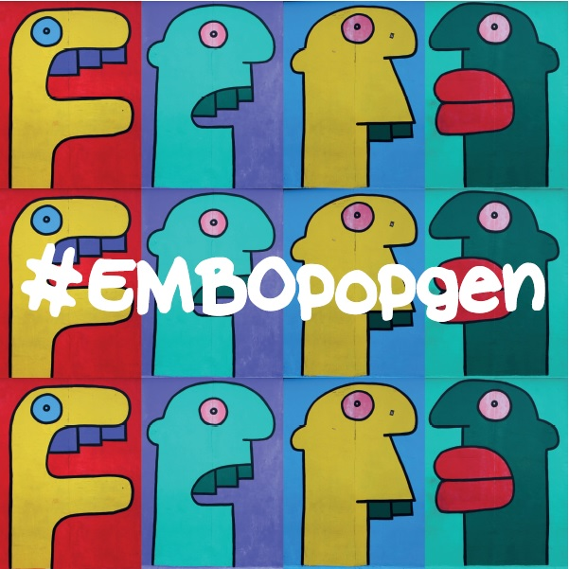
Inferring population structure and admixture histories
Leo Speidel, Lucy van Dorp
UCL Genetics Institute and the Francis Crick Institute
Leo.speidel@outlook.com

Slide 2
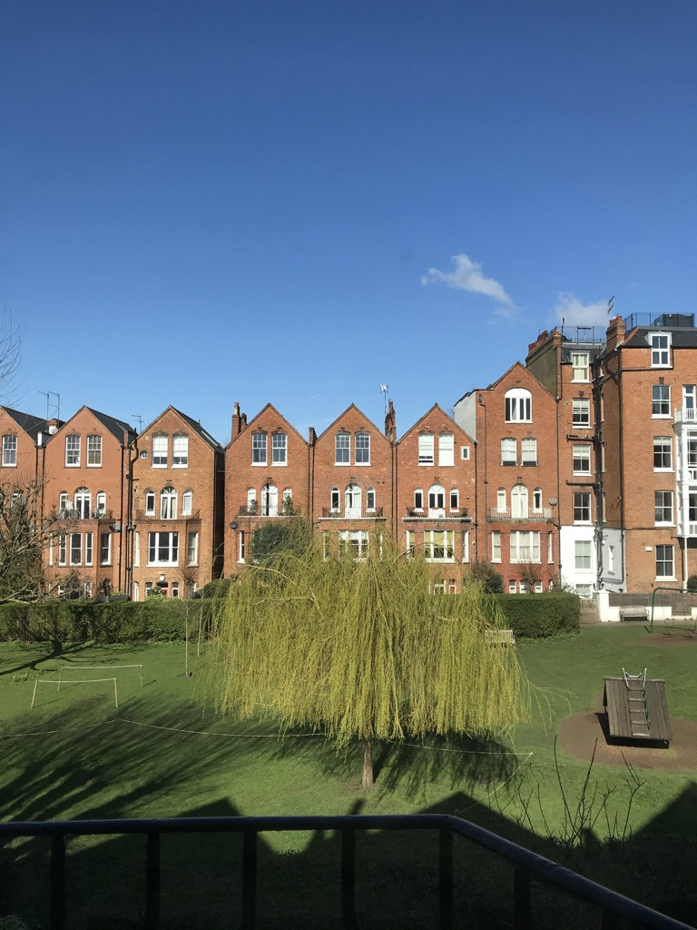

View from my window in London
Lucy van Dorp

Slide 3
Genetic diversity in populations
Genome-wide patterns of variation across individuals provide a powerful source of data
Genetic diversity is underpinned by the key ancestral processes
Genetic Drift
Mutation
Recombination
Selection
There are many different ways of measuring population differentiation and also many different types of data, from allele frequencies at single polymorphic sites (or multiple unlinked sites) to full haplotypic sequences in coding or noncoding regions.
Notes:
I know some of the talks earlier this week discussed some of the forces that have shaped genetic diversity in populations
In particular thinking about the key ancestral processes of genetic drift, mutation, recombination, selection
One of the first step in quantifying the impact of these different forces and what these may mean for our understanding of demographic histories, both in humans and also in other organisms, is to be able to identify and quantify how populations may differ.
And in parallel being able to quantify population differences or structure is an important control for identifying loci under selection or causally implicated in different traits. It also of relevance for species monitoring and to know how much diversity is present in populations and which members might may represent admixed or migrant species.

Slide 4
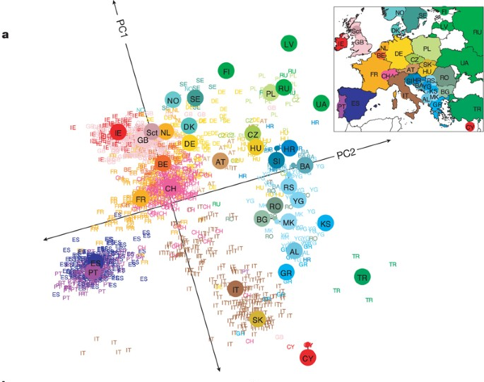
Genetic structure: spotting patterns in genetic variation
Genetic variation correlates with geography (Genes mirror geography)
PCA is a great & easy way to visualise genetic structure
Requires no prior knowledge
But cannot quantify finer-scale structure and difficulties attributing to specific evolutionary events
Novembre et al, Nature, 2008
Notes:
We’ll start with a schematic overview of some of the major mechanisms of determining population structure.
Cartoon example of three populations.
You can see here that PCA – which takes multidimensional data and collapses it into a reduced number of dimensions which maximally explain the data - can be easily used to visualise structure and it doesn’t require any prior knowledge.
Another approach is clustering approaches like ADMIXTURE and STRUCTURE which can provides estimates of the proportion of each individual genomes from populations 1, 2 and 3 are inferred to share.
While we can also detect particularly tracts in which parts of the genome are inherited from which ancestors in a population using chromosomal painting approaches
I’ll focus on these last two in this talk – how we go about doing this, some of the challenges and downstream uses of having resolved genetic diversity in these ways

Slide 5
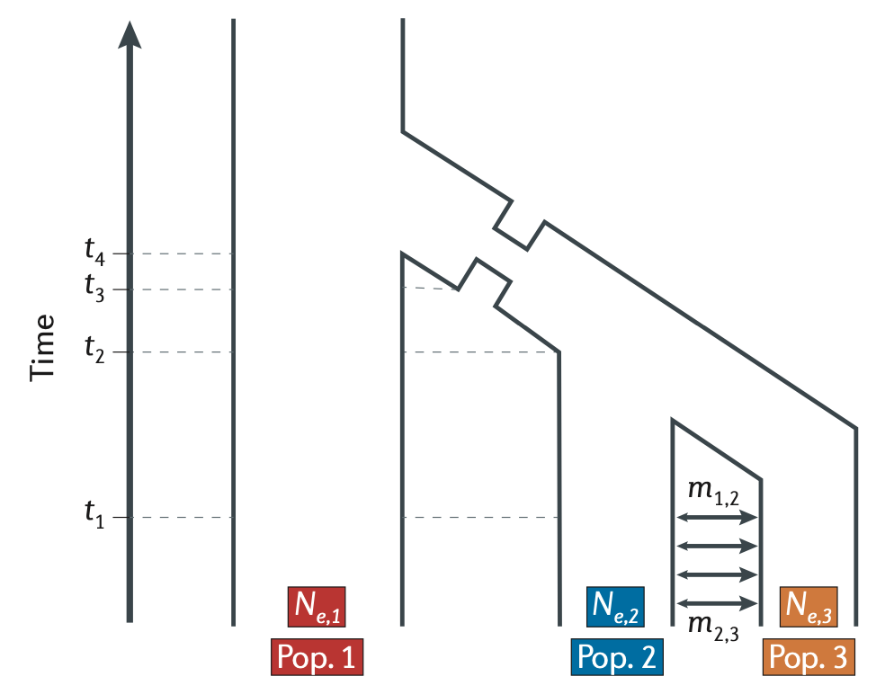
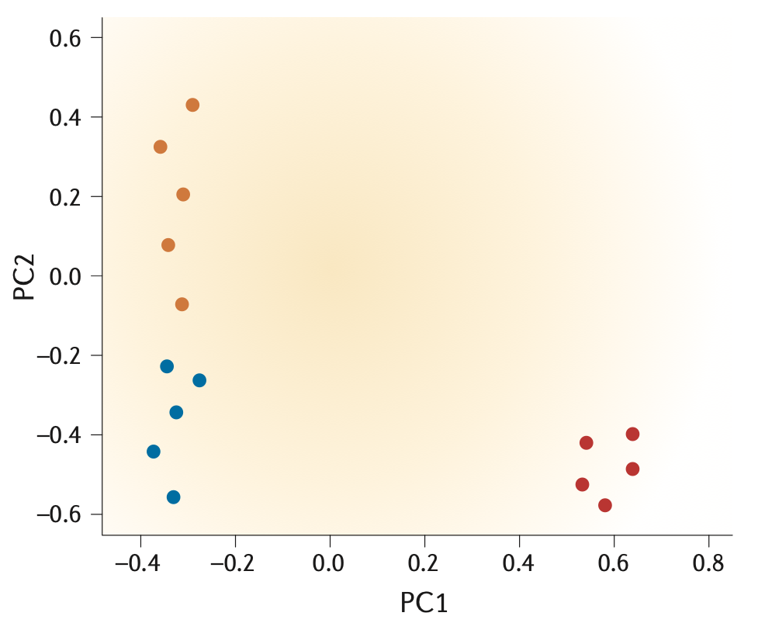
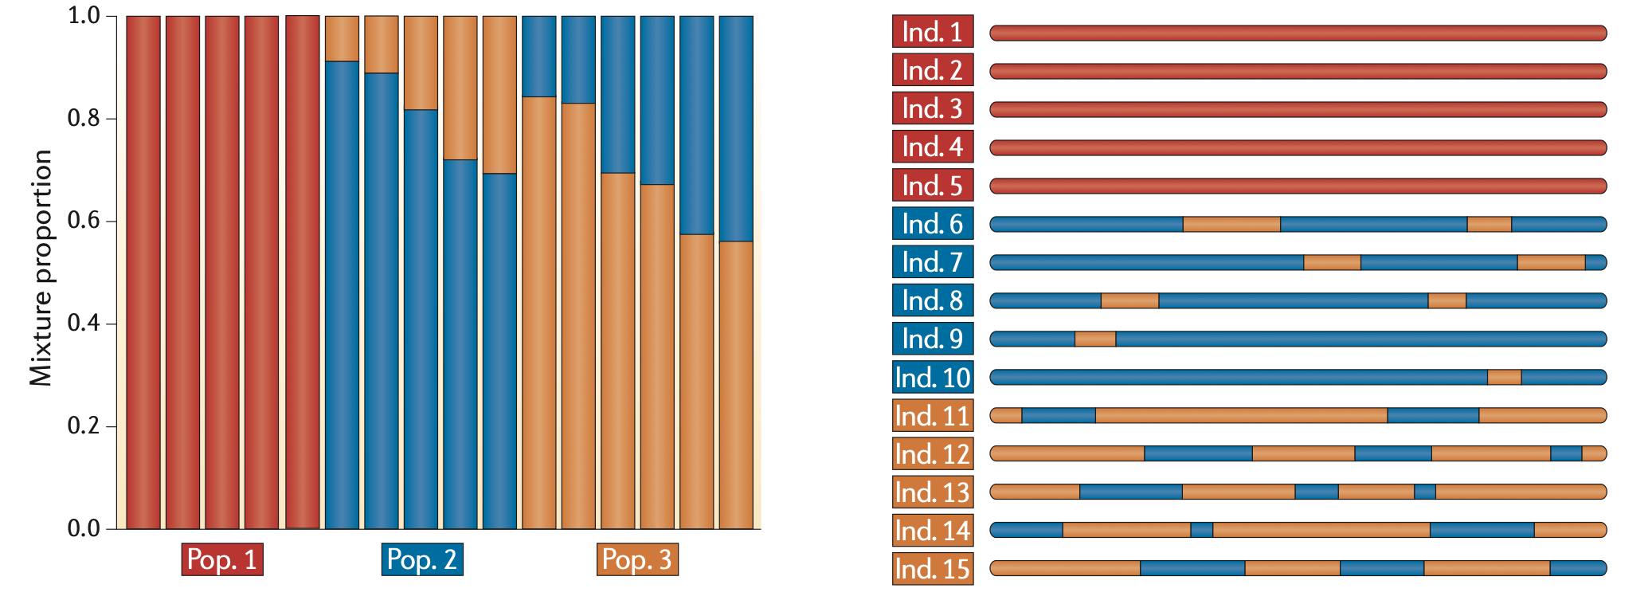
Different approaches for determination of population structure
Allele frequency-based
Haplotype-based
Adapted from Schraiber & Akey. Nature Review Genetics. 2015.
Notes:
So we’ve talked about the underlying framework of model based clustering
Some major advantages of these methods is they are reasonably fast and easy to run and give a good approximation to diversity in a dataset – even if care must be taken in the interpretation. We’ll run ADMIXTURE in the practical.
Methods tend to be based on allele frequencies at unlinked sites.
Going beyond this we are often interested not only in the genome-wide ancestry but the ancestry at different loci – and to acknowledge the fact that loci in recombing populations can display different patterns of linkage

Slide 6
Different approaches for determination of population structure
Name | Data type | Inference | Notes | Ref
STRUCTURE | Unlinked multi-allelic genotypes | Population structure, admixture | User friendly GUI; can be computationally demanding | Pritchard, Stephens & Donelly. Genetics. 2000.
ADMIXTURE | Unlinked bi-allelic SNPs | Population structure, admixture | Estimates the number of populations via cross-validation error | Alexander, Novembre, & Lange. Genome Res. 2009.
fineSTRUCTURE | Phased haplotypes | Population structure, admixture, chromosome painting | Can be used to identify the number and identity of populations | Lawson, Hellenthal, Myers & Falush. PLoS Genet. 2012.
GLOBETROTTER | Phased haplotypes | Population structure, admixture, chromosome painting | Estimate unsampled ancestral populations and admixture times | Hellenthal et al. Science. 2014.
Adapted from Schraiber & Akey. Nature Review Genetics. 2015.
Notes:
At the point of having a well curated set of genotypes there are many ways of going about determining population structure
Highlighting some major methods here – some of which we’ll also discuss and use in the practical

Slide 7
Allele frequency-based clustering
Thought experiment:
Assume we sequenced individuals we knew are
from Pop 1 and Pop 2
We now sequence another individual, where we are unsure whether they are from Pop1 or Pop 2
How could we try to assign this individual to Pop1 or Pop 2?
Pop 1
Pop 2
Allele frequency in Pop1 Pop2 Genotype of individual
SNP1 0.8 0.4 1
SNP2 0.3 0.7 0
SNP3 0.4 0.6 1
SNP4 0.9 0.1 1
→ Pop1?
→ Pop1?
→ Pop2? (Pop1?)
→ Pop1?

Slide 8
Allele frequency-based clustering
We can do the same without knowing allele frequencies in Pop1 and Pop2 by clustering
One locus:
2/7 x
5/7
5/7
5/7
2/7 x
5/7
5/7
4/5
4/5
1/5 x
4/5
4/5
Test how well (probability) each ind fits the allele frequency of its cluster; if bad fit → move individual to a different cluster
Pr( ) = 5/7
Pr( ) = 2/7
individuals
Pr( ) = 1/5
Pr( ) = 4/5
i
Notes:
Start with simplest – allele frequency based clustering
- Essentially taking sets of genotypes from individuals and grouping them into clusters based on genetic similarity
- I’ll talk through the premise underlying the STRUCTURE algorithm
So lets as a simple example take 12 haploid individuals
And we have the SNPs for each one of these individuals I as 1 through L – the colour of the circles is just denoting a genotype – black or white
Lets classify 12 (haploid) individuals into a randomly proposed K = 2 clusters – trying out the pink and the blue here
For any allele we can assess its frequency in the cluster as –j – example for one allele
Test the fit

Slide 9
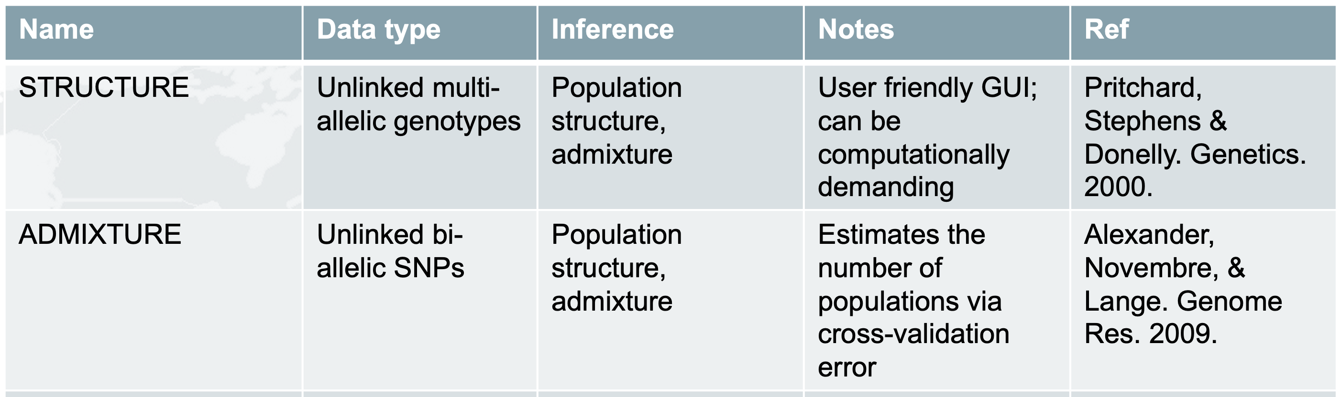
Allele frequency-based clustering
LD prune
Test how well (probability) each ind fits the allele frequency of its cluster; if bad fit → move individual to a different cluster
“no admixture model” – assign each ind i to single cluster k
“admixture model” – assign each ind to multiple clusters (i.e. infer % of ind i ’s genome assigned to clusters 1, ..., K )
“linkage model” – can identify regions of ind i assigned to each cluster (Falush et al 2003, Genetics 164:1567)
Spatial priors on cluster membership.
Notes:
One critical point here is that you can see the contribution of each site is considered independently – this is one of the reasons to prune for SNPs in high LD before running such clustering algorithms
There are also different methods rather than sampling via MCMC, for instance ADMIXTURE maximises the likelihood using high dimensional optimisation.
And also algorithms like STRUCTURE can be implemented in multiple ways – no admixture model, admixture model, linkage model
Also suite of tools– eg. Geneland which use spatial priors on cluster membership – useful if have georeferenced data and a sample with high levels of isolation by distance

Slide 10
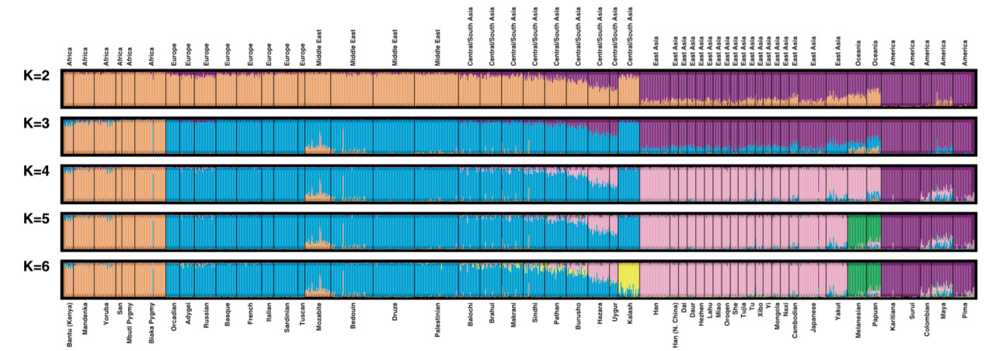
Allele frequency-based clustering
Human Genome Diversity Panel
Rosenberg et al. Science. (2002), 298, 5602, 2381-2385.
Accuracy of population identification depends on the number of individuals included, the number of loci used and the allele frequency differences among those populations.
Population identification can be strongly affected by the amount of admixture within individuals and the proportion of admixed individuals in the dataset – all populations are admixed….
Notes:
Of course these methods have been applied very successfully – and model-based clustering has become a popular approach to visualise the genetic ancestry of humans and other organism
textbook example is from Rosenberg et al which partitioned the variation observed in global human populations using ADMIXTURE based clustering. Values of K-2 through to K=6.
At K=2 diversity is partitioned into Africa, Europe, the Middle East. Central South Asia compared to East Asia, Oceania and the Americas
At K-3 African populations are split from Europe, Middle East and Central South Asia
K=4 allows separating of East Asia from Oceanian and American groups
K=5 Oceania groups are split from the Americas
K-6 Kalash
So while this is recovering major population structure there are some important observations here
For instance, without question one of the biggest determinants of genetic diversity in human populations is the out of African migrations of modern humans around 70,000 or so years ago. Strong differing patterns of LD and heterozygosity in African and non-African groups but at K-2 we do not split Africa from not Africa. One plausible explanation being the low number of African individuals included in this dataset
Inferred literally we might, at K=6, consider the populations of the world can be divided into the major continental groupings plus the Kalash, an isolated population within Pakistan. It turns out that this is because the Kalash are relatively drifted from the other HGDP groups due to isolation, as they live within a mountainous isolated region that can be difficult to access. These and other signals captured using different models have been interpreted as the Kalashbeing an ancient genetic isolate that has had little or no contact with other world wide groups for many thousands of years. However, recent work has provided evidence that ancestors of the Kalash have in fact recently intermixed with other groups within the last 3000 or so years, again, illustrating the difficulty in inferring demography using modern day genomes alone.

Slide 11
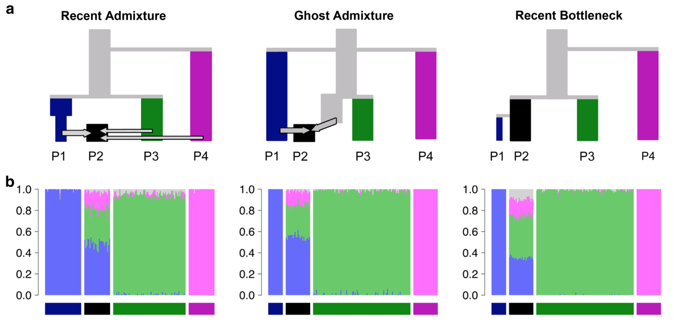
Allele frequency-based clustering
Different combinations of drift, admixture and ancient relatedness can give similar signals
Recent admixture of P1, P3 & P4
Some parallels to African Americans
P2 50:50 admixture of P1 and unsampled population most closely related to P3
P1 – a sister population to P2 that underwent a strong recent bottleneck
Taken from :
A tutorial on how not to over-interpret STRUCTURE and ADMIXTURE bar plots
Lawson, van Dorp, Falush, Nat Commun 2018
Notes:
To highlight some of these challenges you can simulate some scenarios and look at how unsupervised clustering behaves.
……..
How do admixture plots look?

Slide 12
Allele frequency-based clustering
Different combinations of drift, admixture and ancient relatedness can give similar signals
Lawson, van Dorp & Falush. Nat Comms. (2018).
Notes:
First thing to note is they all look essentially the same!
For the recent admixture scenario – a scenario where admixture should work well – ADMIXTURE indeed performs well – it estimates approximately correct admixture proportions (true admixture proportions are 50% blue 35% light green and 15% light pink) and we can interpret P2 as an admixed population.
In the “Ghost Admixture” the unsampled population is modelled as a mix of the sampled populations P3 and P4 that it is most closely related to, rather than being given its own ancestral population.
If we look at P2 you can see the larger proportion of ancestry inferred from the light green population rather than the light pink one does not reflect a difference in admixture proportions, because neither P3 nor P4 actually contributed genetic material to P2. Rather, it reflects the fact that P3 is more closely related to the unsampled ghost population, as seen in the phylogeny.
In the Recent Bottleneck scenario, ADMIXTURE models the genetic drift shared by P1 and P2 by assigning both populations some ancestry from the blue ancestral population. Because of the recent specific drift in P1, P1 is approximately modelled by assigning more blue ancestry to P1 than to P2, thereby making P1 more distinct from the other populations in the sample. The remaining ancestries assigned to P2 are from the most closely related of the remaining ancestry components, again in proportions that reflect genetic distance rather than admixture fractions.

Slide 13
Allele frequency-based clustering
Different combinations of drift, admixture and ancient relatedness can give similar signals
Lawson, van Dorp & Falush. Nat Comms. (2018).
Ancestry assignments in STRUCTURE/ADMIXTURE often termed admixture proportions they do not identify where admixture has occurred → they do not alone indicate a history of admixture.
Notes:
So it is not sufficient to use ADMIXTURE alone to infer the histories of populations
Other important point is these are often termed admixture proportions – but do not identify where admixture occurs!

Slide 14
Determination of population structure
Allele frequency-based
Haplotype-based
Adapted from Schraiber & Akey. Nature Review Genetics. 2015.
Notes:
So we’ve talked about the underlying framework of model based clustering
Some major advantages of these methods is they are reasonably fast and easy to run and give a good approximation to diversity in a dataset – even if care must be taken in the interpretation. We’ll run ADMIXTURE in the practical.
Methods tend to be based on allele frequencies at unlinked sites.
Going beyond this we are often interested not only in the genome-wide ancestry but the ancestry at different loci – and to acknowledge the fact that loci in recombing populations can display different patterns of linkage

Slide 15
Incorporating haplotype information
The genome as a mosaic
- blocks of LD separated by recombination
Notes:
Can think of the genome as divided up into separate chromosomal chunks or haplotypes – each with their own ancestral origin, physical length and population frequency.
Identifying these blocks can be used to identify admixture chunks, infer recombination rates and we can use that information to resolve fine-scale levels of population structure which cannot be identified using unlinked markers alone.
You're here later to day from Leo - estimates of changes in effective population sizes and selection

Slide 16
Incorporating haplotype information
Name | Data type | Inference | Notes | Ref
HAPMIX | Phased haplotypes, reference panel | Chromosome painting | Requires populations to be pre-specified | Price et al. PLoS Genetics. 2009
LAMP | Phased haplotypes | Chromosome painting | Identifies local ancestry in windows, rather than using an HMM | Sankararaman et al. Am. J. Hum. Gen. 2008.
PCAdmix | Phased haplotypes | Chromosome painting, population structure | Uses PCA in small chunks followed by HMM to estimate local ancestry | Brisbin et al. Hum. Biol. 2012.
fineSTRUCTURE | Phased haplotypes | Population structure, admixture, chromosome painting | Can be used to identify the number and identity of populations | Lawson, Hellenthal, Myers & Falush. PLoS Genet. 2012.
GLOBETROTTER | Phased haplotypes | Population structure, admixture, chromosome painting | Estimate unsampled ancestral populations and admixture times | Hellenthal et al. Science. 2014.
Adapted from Schraiber & Akey. Nature Review Genetics. 2015.
Notes:
Of course many methods – again just flagging some here
Focus on ones I know
But all rely on underlying inference method of chromosome painting

Slide 17
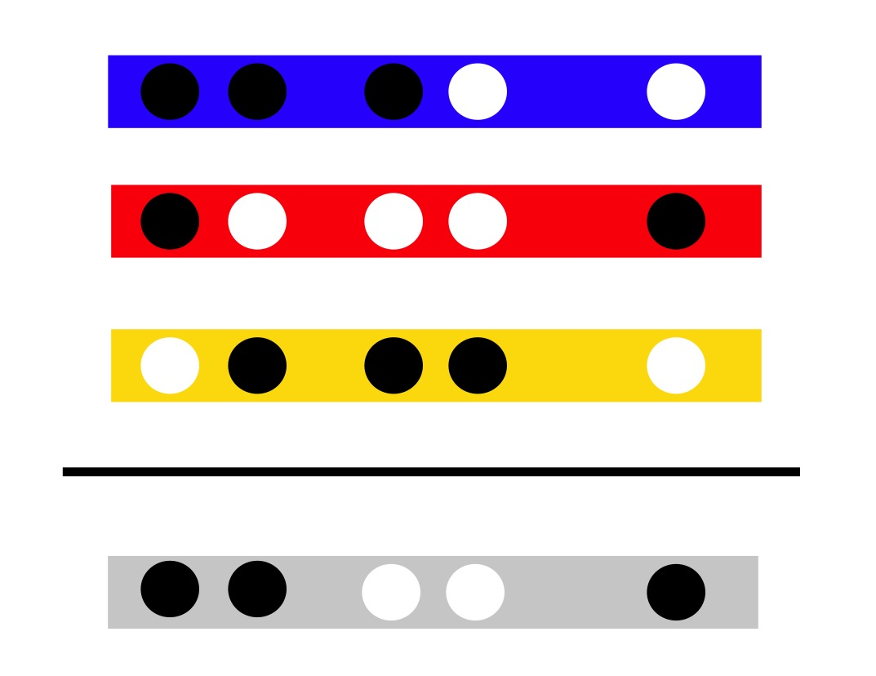
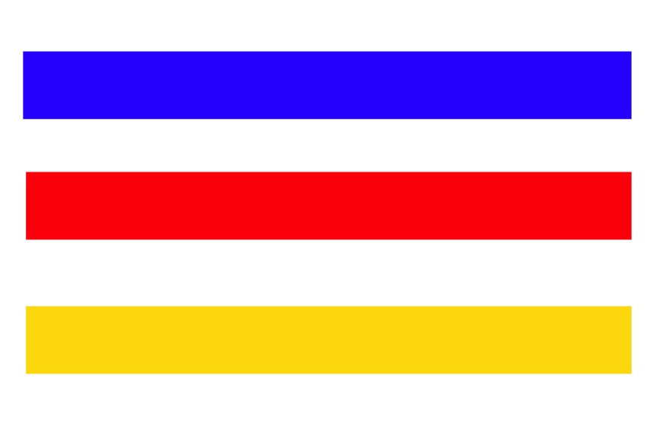
Incorporating haplotype information Chromosome painting
African Donor
European Donor
East Asian Donor
Li & Stephens, Genetics, 2003
Lawson et al, PLoS Genetics, 2012
Notes:
Many of these methods required phased data as input and rely on the methodological framework of chromosome painting.
I’ll talk through a cartoon of the intuition behind the approach.

Slide 18
Incorporating haplotype information Chromosome painting
African Donor
European Donor
East Asian Donor
Li & Stephens, Genetics, 2003
Lawson et al, PLoS Genetics, 2012

Slide 19

Incorporating haplotype information Chromosome painting
African Donor
European Donor
East Asian Donor
Recipient
group/individual
Li & Stephens, Genetics, 2003
Lawson et al, PLoS Genetics, 2012

Slide 20
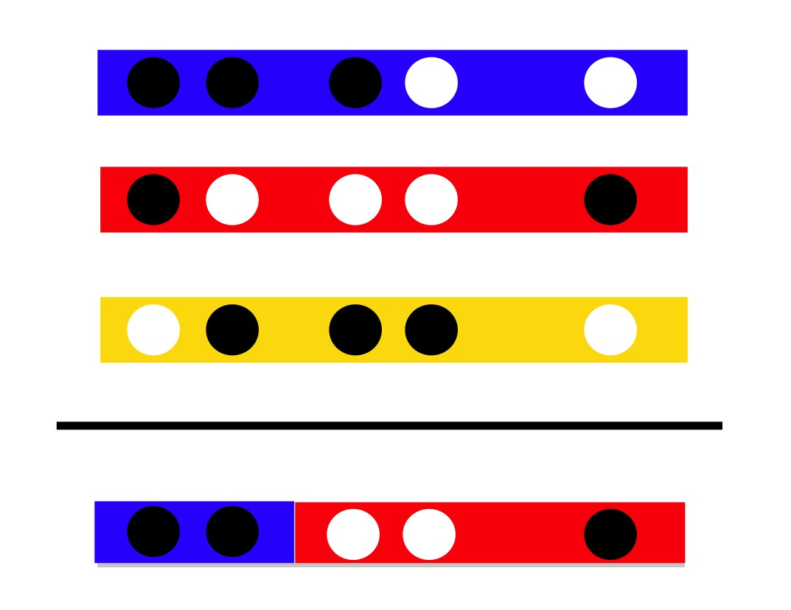
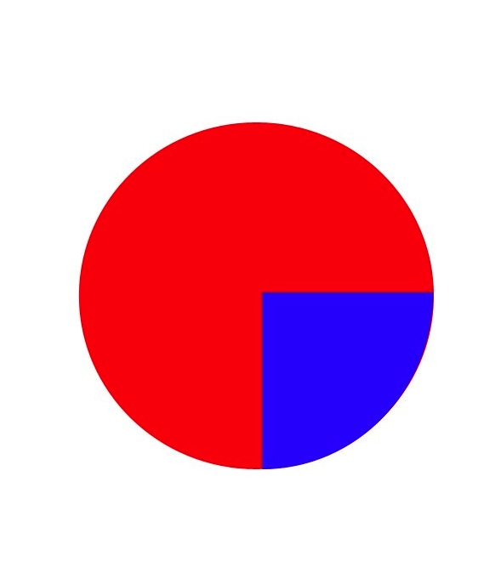
Incorporating haplotype information Chromosome painting
African Donor
European Donor
East Asian Donor
Recipient
group/individual
Painting Profile
Li & Stephens, Genetics, 2003
Lawson et al, PLoS Genetics, 2012
Notes:
Which most closely related to relative to other donors
Who you are most related to changes as you move along the genome
First two SNPs are related ancestrally most closely to Africa
Several algorithms to do this efficiently – achieved using a hidden markov model – Li & Stephens copying model – includes the software Chromopainter and HapMix.
Makes use of an HMM →
the observed state is SNP data at a locus
the hidden state is the donor which is copied.
Now other methods based on unlinked information – PCA, admixture, structure – at blue SNP equally likely East Asia and Africa – but using LD gain more

Slide 21
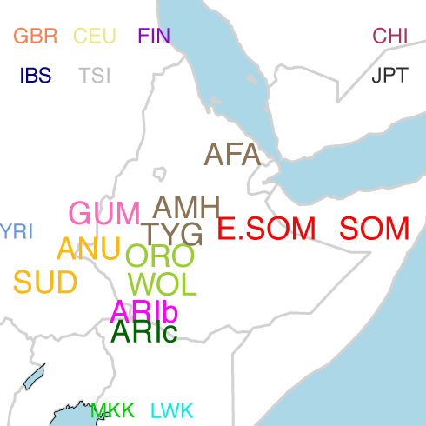
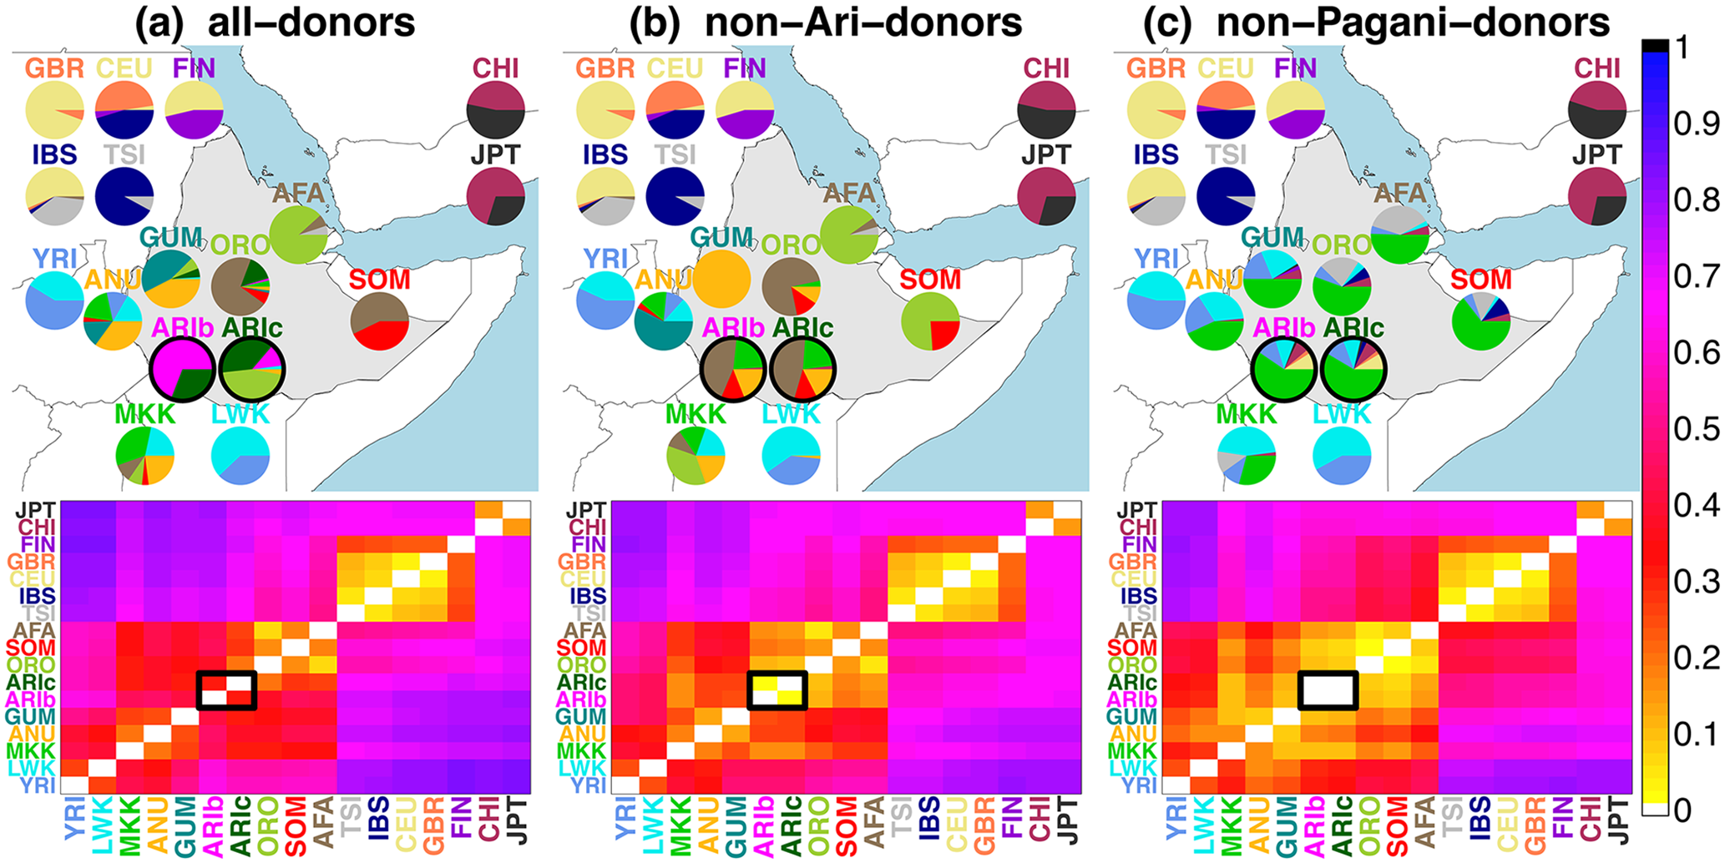
Incorporating haplotype information Chromosome painting
All-donors
ARI blacksmith/
ARI cultivators
Average haplotype length shared = 2.76cM
van Dorp et al, PLoS Genetics, 2015
Notes:
And of course you can also change up the donors which can provide different levels of information.
Typical analysis – you’ll do one later today – is to take all the samples in your dataset and to paint their DNA compared to everyone elses.
I’m just showing an example here of some work we did on human population in Ethiopia in particularly focusing on communities in the Ari of the southwestern part of the country. You can take a large global dataset and paint the Ari using everyone, including members of their own population
Here are the painting profiles (matching to own groups)

Slide 22
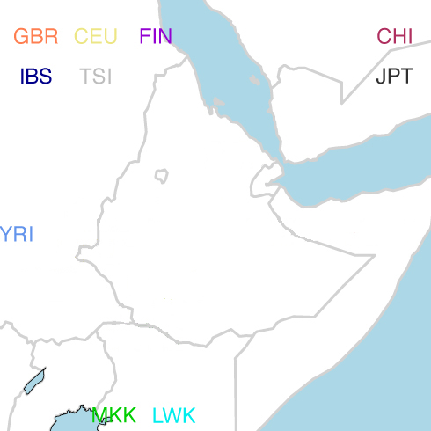
Incorporating haplotype information Chromosome painting
No Ethiopia
ARI blacksmith/
ARI cultivators
Average haplotype length shared = 0.65cM
van Dorp et al, PLoS Genetics, 2015
Notes:
But you can then also ask what happens if you use only human populations outside of Ethiopia as donors – this removes recent mixing events from being considered.
You can see when we do this the average length of haplotypes is smaller – suggesting you’re picking up signals from older events – that have been broken up by more recombinations.
Now looking at painting profiles you can see groups in Ethiopia look more similar to each other
And in particularly the big differences we saw between the Ari communities we looked at in detail disappear – suggesting they a more likely to share the same recent ancestry, only looking very genetically different today due to high population specific drift

Slide 23
Haplotype clustering
Clustering
fineSTRUCTURE
Painting Profile
Li & Stephens, Genetics, 2003
Lawson et al, PLoS Genetics, 2012
Notes:
So we’ve seen that we can use chromosome painting patterns to explore different levels of genetic information – capturing different patterns of recombination and LD. But we can also use the profiles from chromosome painting to cluster individuals just as we saw we could do with algoirthms like STRUCTURE and ADMIXTURE

Slide 24
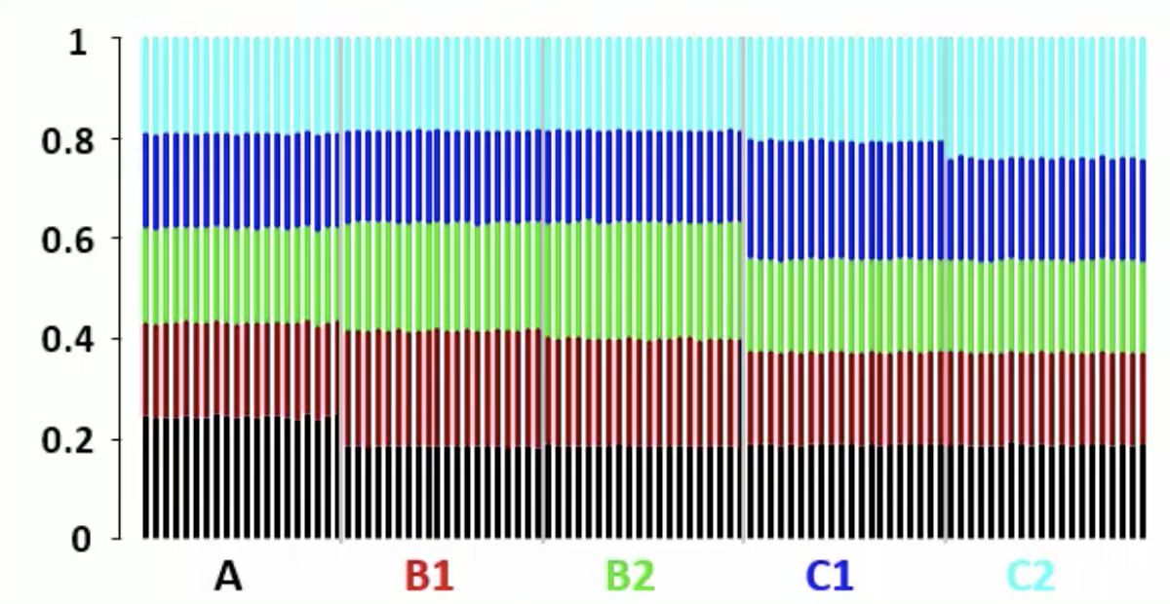
Haplotype clustering
Simulation:
3K years
2K years
1K years
A
B1
B2
C1
C2
Painting profile
Donor individual = j
Recipient individual = i
Number of chunks of DNA by which individual I is painted by individual j = Yij
Lawson et al. PLoS Genetics, 2012
Notes:
As an example here, five populations were simulated according to the given tree with population A at left, splitting from groups B and C 3000 years ago, followed by populations C1 and C2 at right splitting from each other 2000 years ago, then populations B1 and B2 in the middle splitting 1000 years ago.
We then sample 20 individuals from each of the five populations at the bottom of the tree at the present day.
STEP1 -
Then we paint each individual "i" using all other individuals as donors.
These are the stacked up painting profiles for each individual (column) – the colour gives the proportion of DNA from each population that paints each of the individuals.
From this we can tabulate Yij, which is the number of DNA segments by which individual "i" is painted by individual "j".
Differences are subtle owing to the fact that these splits in the tree at top left are all relatively recent. Hopefully, you can see differences amongst the columns.
Use a very similar approach to we discussed for Admixture – but now rather than using the SNP genotypes we can use the segment counts – the Yij values.

Slide 25
Haplotype clustering
3K years
Assign individuals to a random set of clusters k
(Y_{i1},…,Y_{ik}) ~ Mult(P_{A1},…,P_{Ak}) for ind I assigned to cluster A
Infer P_{AK} – number of chunks individuals in cluster A are painted with individuals in cluster k
Test if Pr(Y_{i1},…,Y_{ik}) is low – if so change cluster and repeat!
2K years
1K years
A
B1
B2
C1
C2
Painting profile
Donor individual = j
Recipient individual = i
Number of chunks of DNA by which individual I is painted by individual j = Yij
Lawson et al. PLoS Genetics, 2012
Notes:
We assign individuals to a random set of clusters K
We consider the probability
FineStructure model assumes that the Yi values - the number of DNA chunks by which individual I is painted by donor individuals from each of the K clusters you’ve proposed is multinomially distributed with probabilities PAK, with A reflecting the current cluster assignment of individual I.
We can infer the PAK by using the number of DNA segments that individuals assign to cluster A, are painted with individuals assigned to cluster K. You can then test the probability of the observed DNA segment counts of I is low according to this multinomial model. And if so, you move individual I to a different cluster and repeat for several MCMC iterations.

Slide 26
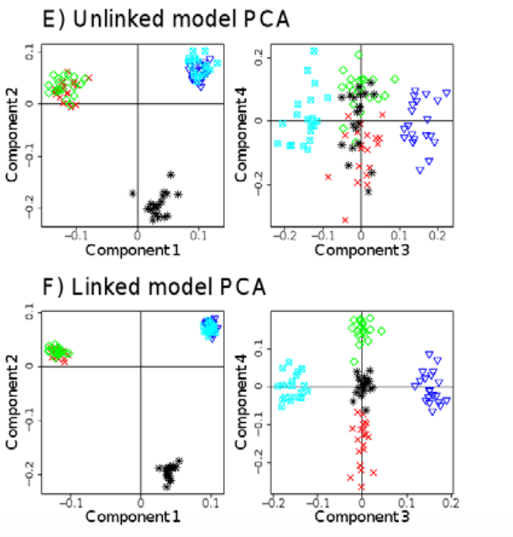
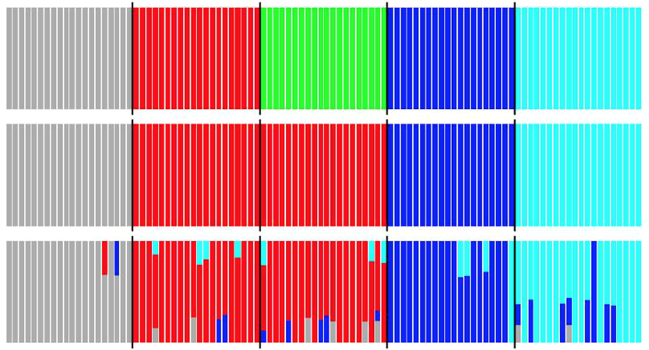
Haplotype clustering
3K years
2K years
1K years
A
B1
B2
C1
C2
Lawson et al. PLoS Genetics, 2012
Notes:
Final clustering – correctly identifies there are five populations
We can’t recover this using unlinked data
Or unsupervised ADMIXTURE

Slide 27
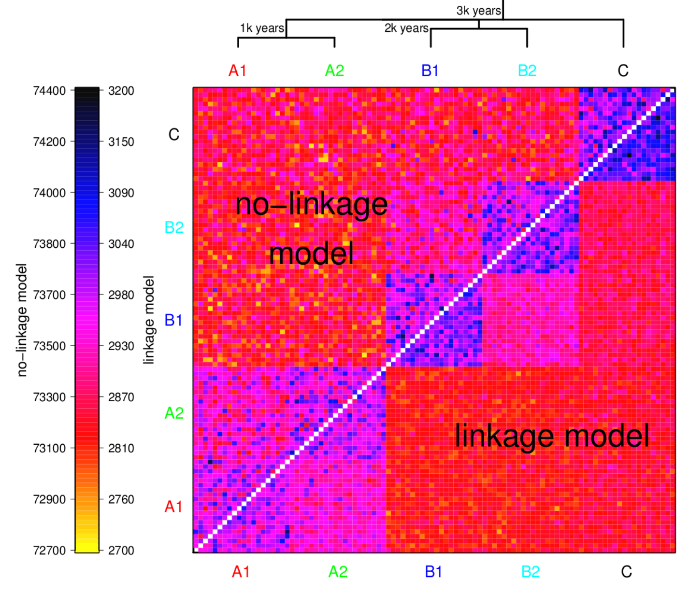
Haplotype clustering
Notes:
Heatmap – often depicted
Upper left – ignoring haplotypes
Lower right – using haplotypes

Slide 28
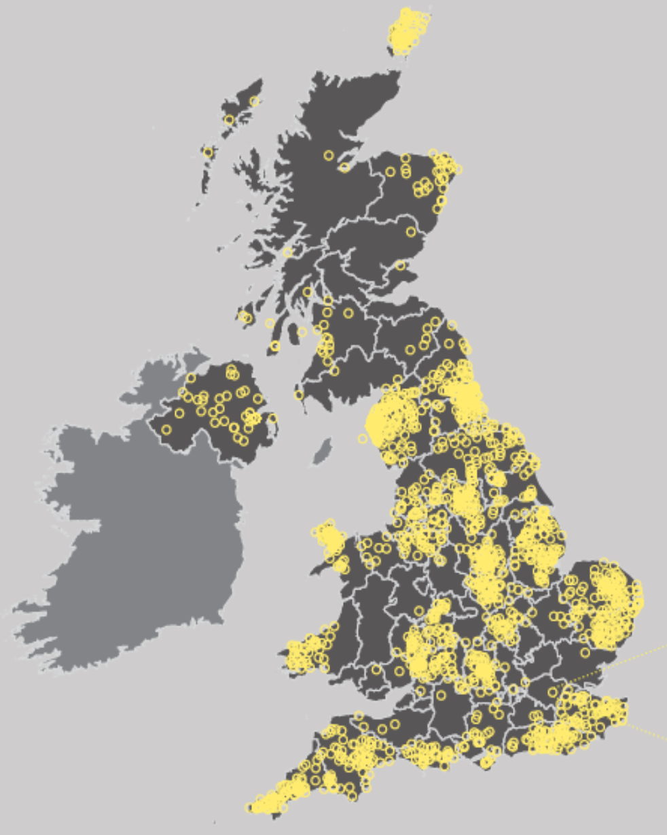
Haplotype clustering in the British Isles
2,039 individuals collected across rural areas of UK
All four-grandparents born within 80km of one another
Inferred DNA matching patterns amongst all individuals
Grouped individuals into hierarchical groups based on these DNA patterns
Leslie et al. Nature, 2015
Notes:
A good example for the need of fine-scale inference
Genetic data from over 2000 British individuals under the criteria that all 4 grandparents from the same region
Clustering based analysis shows genetic differentiation within the British isles with remarkable concordance between genetic clusters and geography.
We can use a painting approach to paint using European populations to reveal the legacy of demographic events.
For example the genetic contribution to southeastern England from Anglo-Saxon migrations

Slide 29
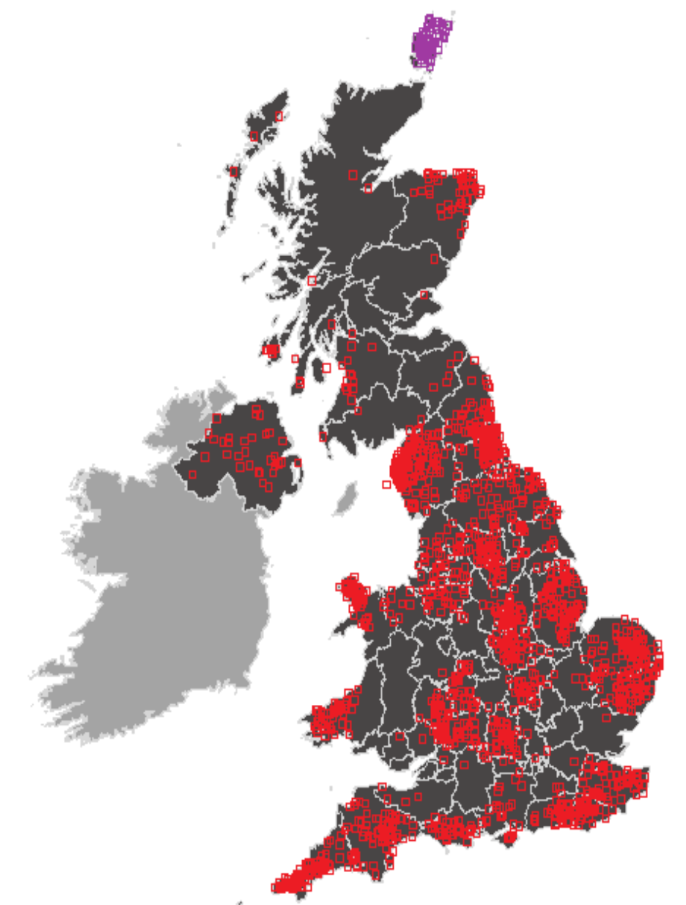
Haplotype clustering in the British Isles
Leslie et al. Nature, 2015

Slide 30
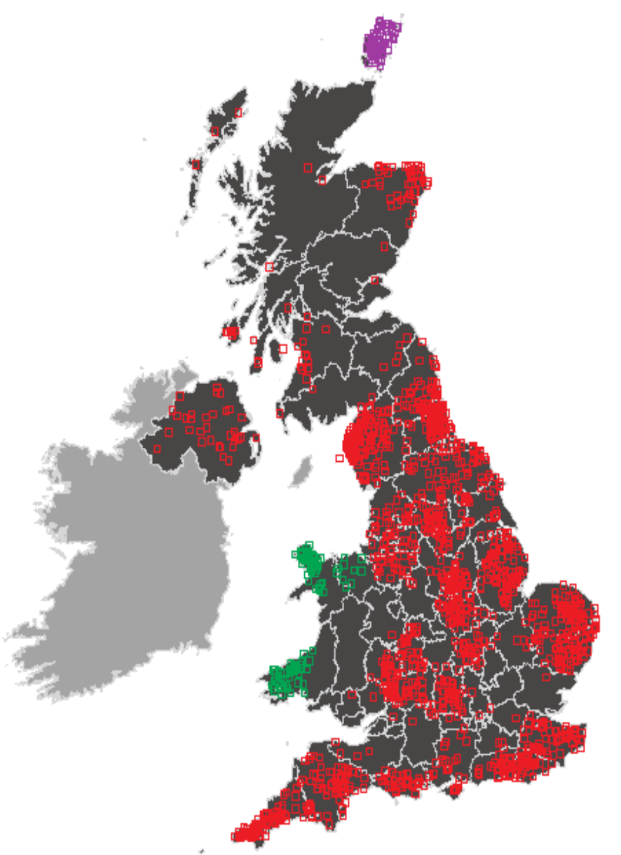
Haplotype clustering in the British Isles
Leslie et al. Nature, 2015

Slide 31
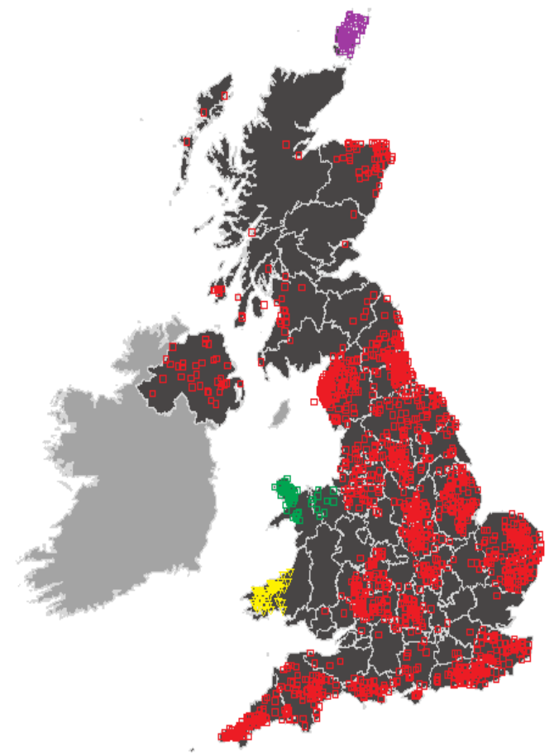
Haplotype clustering in the British Isles
Leslie et al. Nature, 2015

Slide 32
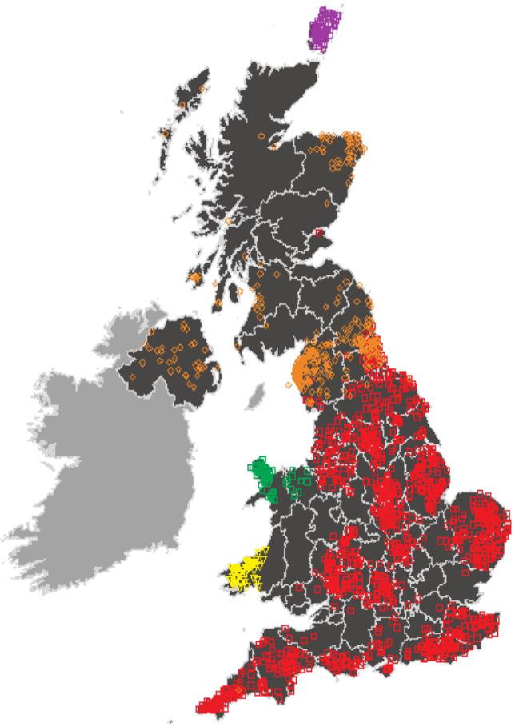
Haplotype clustering in the British Isles
Leslie et al. Nature, 2015

Slide 33
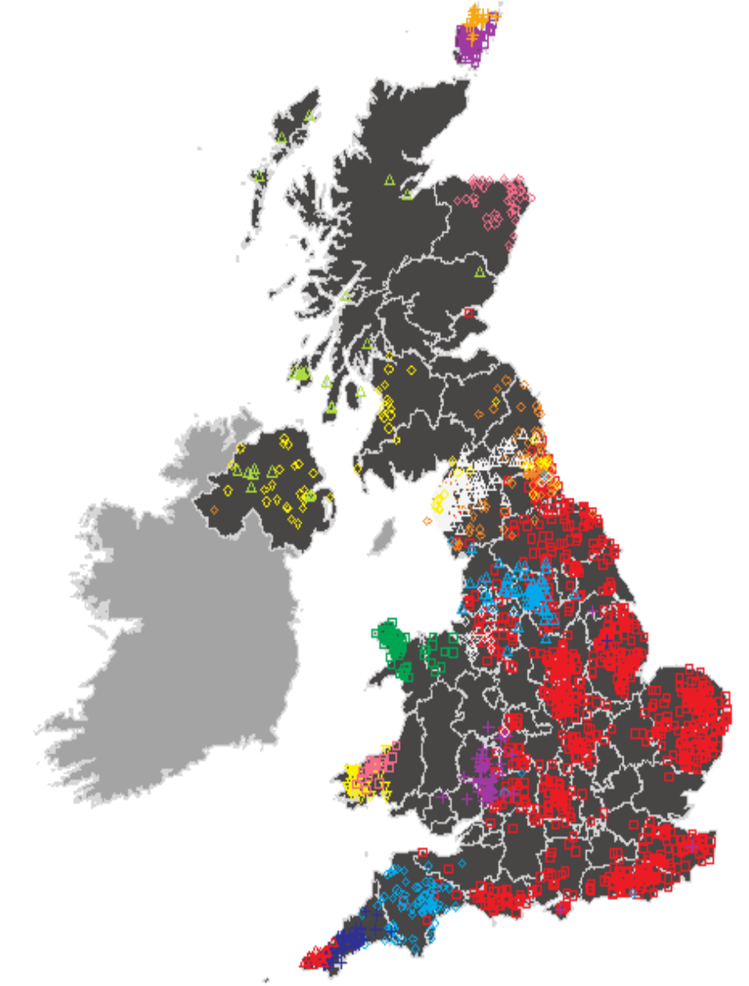
Haplotype clustering in the British Isles
Leslie et al. Nature, 2015
Notes:
Northern Ireland has 2 genetic groups, one also seen in the highlands and another also present in the south of Scotland and England
Differences in individuals from Devon and Cornwall almost match the county border
Red cluster – people with about a quarter German like ancestry and 45% French like ancestry – legacy of Anglo-saxon invasions

Slide 34
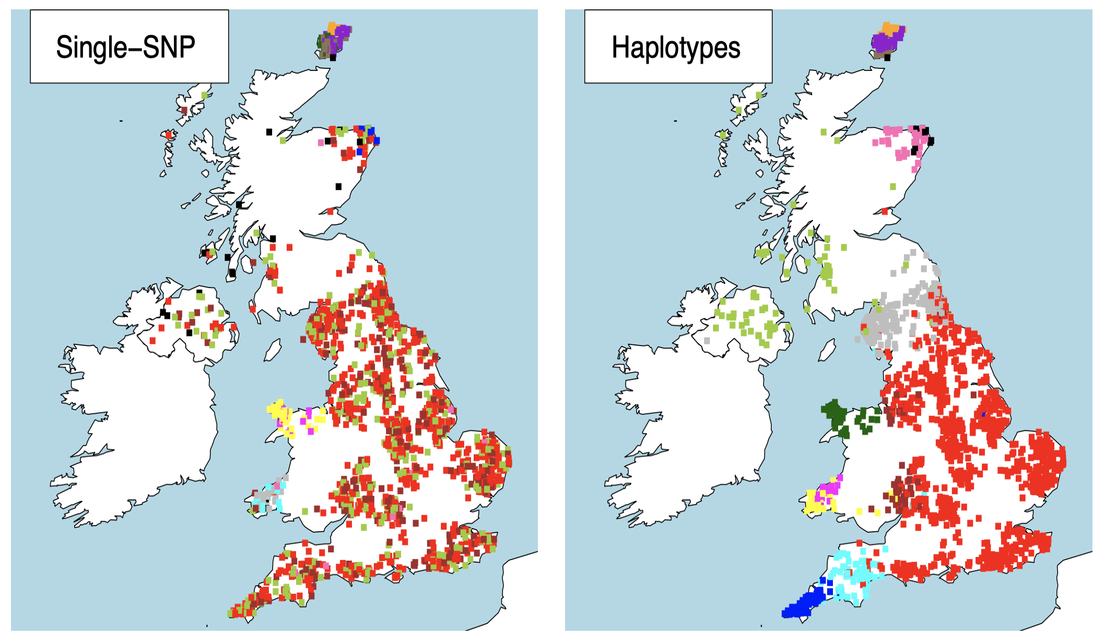
Haplotype clustering in the British Isles
Leslie et al. Nature, 2015

Slide 35
Haplotype clustering - fineSTRUCTURE
Pros and Cons
Advantages:
Increased power to find more subtle population structure
Heatmaps demonstrate presence of structure/admixture
Current implementation infers number of clusters K automatically and builds a tree
Disadvantages
Challenges of interpretation – drift/admixture/other
Requires phased data
Computationally slow compared to ADMIXTURE
Leslie et al. Nature, 2015

Slide 36
Haplotype sharing patterns can also be used to infer admixture events in human populations
Admixture = mixing/interbreeding of two genetically distinguishable groups
We can detect admixture in the genome by exploring patterns of decay of LD over genetic distance using chunks inferred from chromosome painting
Notes:
Haplotype based clustering – reveal patterns of ancestry in the British Isles
In the case of the Ari be used to distinguish recent from more ancient demographic events

Slide 37
Haplotype sharing patterns can also be used to infer admixture events in human populations
Local Pop
Migrant
Gen 0
Gen 1
Gen 2
..….
Gen 7
..….
Gen r
Notes:
Two populations – red and yellow admix r generations ago followed by random mating.
Genetic pieces from each population get smaller each subsequent generation due to recombination

Slide 38

LD decays with genetic distance and this can be used for admixture inference
Genetic recombinations are well modeled by a Poisson random variable (Falush et al, Genetics, 2003) → where the time between ‘arrivals’ of a Poisson process follows an exponential distribution.
The length of red and yellow depends on the number of recombination's that have occurred.
Eg. a continuous tract is one in which no ancestry-breaking recombinations have occurred.
Thus, tract length distribution should be exponential.
Can we use this distribution to approximate the number of generations since admixture?

Slide 39
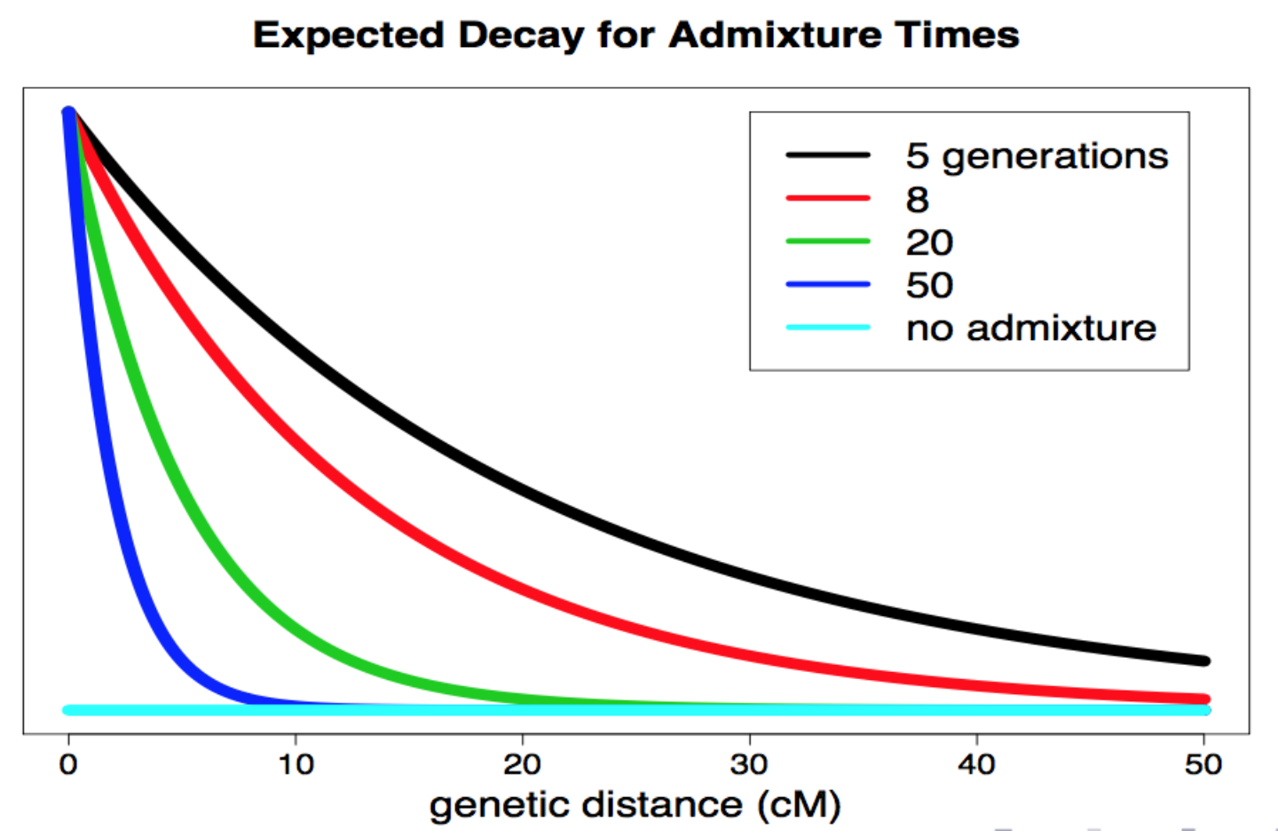
LD decays with genetic distance and this can be used for admixture inference
Linkage disequilibrium (r2)
Notes:
We plot admixture chunk size (red or yellow) on the y-axis and genetic distance between chunks on the x-axis.
The rate of decline of admixture LD follows an exponential or rate R which is directly related to the number of generations since admixture, since that indicates how many recombinations have occurred between any two SNPs.
Excess of large segments in more recent admixture compared to older admixture
fit exponentials to inferred chunk pairs to assess whether admixture has occurred and if so between which sources and when!

Slide 40
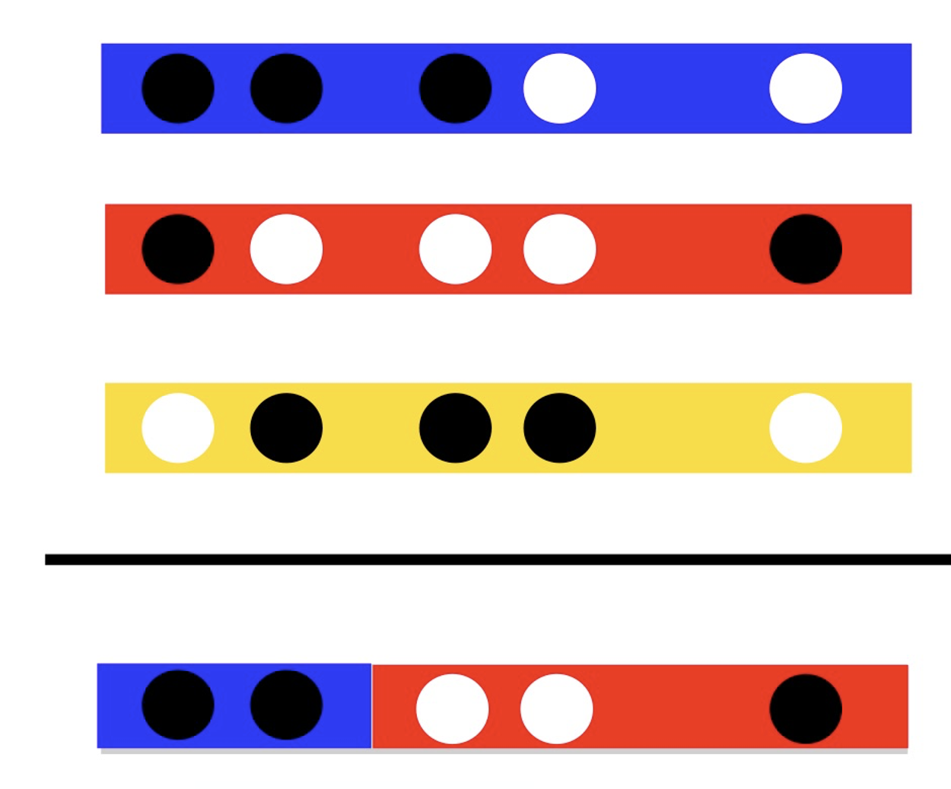
Inferring admixture events in human populations
Several methods that use admixture LD to infer, identify and date admixture events eg. ROLLOFF (Moorjani et al, AJHG, 2013), ALDER (Loh et al, PLoS Genetics, 2013), and GLOBETROTTER (Hellenthal et al, Science, 2014).
DNA → chromosome painting (infer which groups) → size of segments → fit exponentials

Slide 41
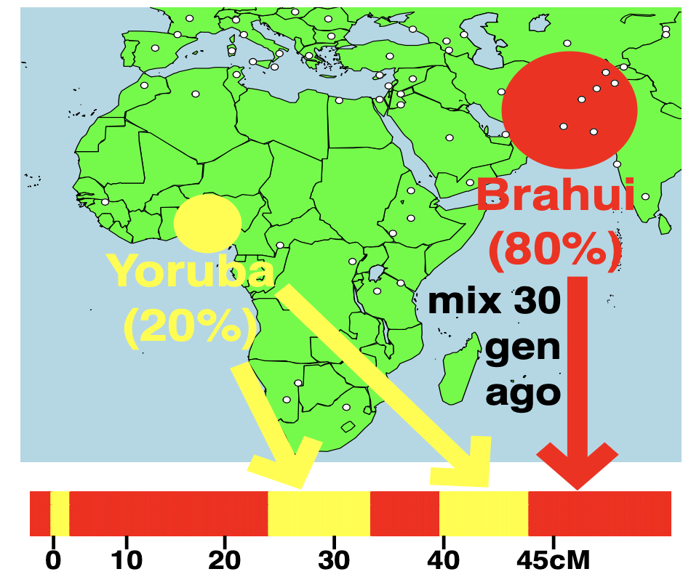
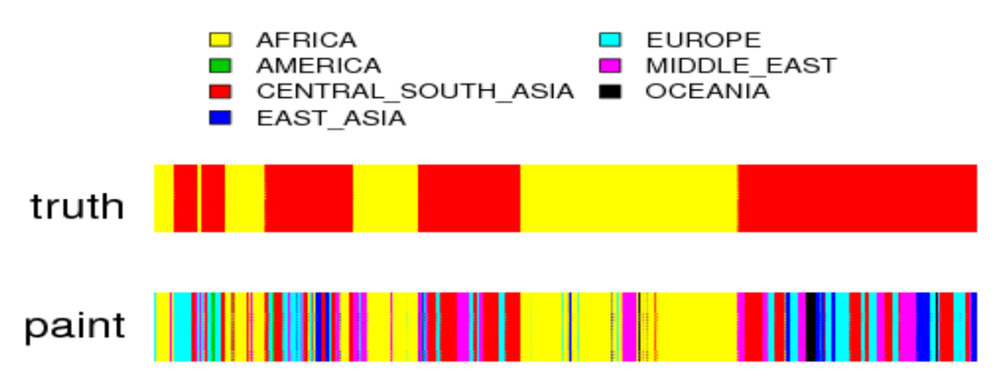
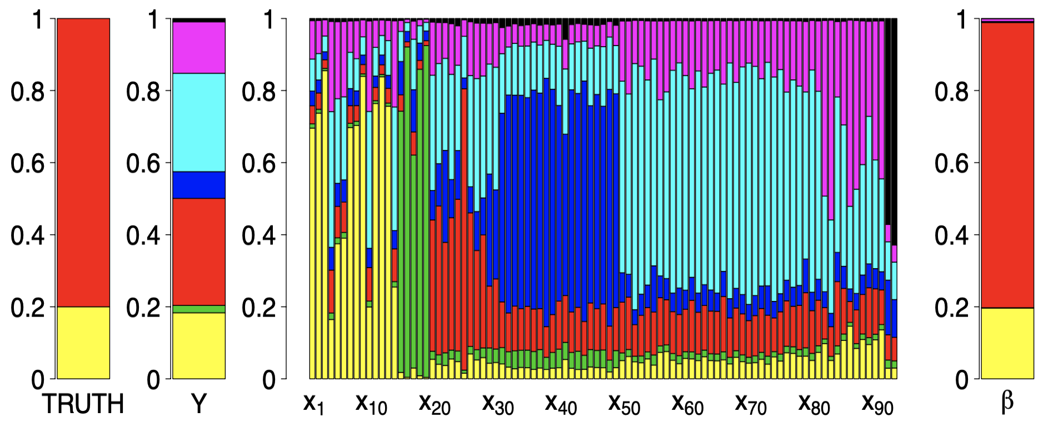
Inferring admixture events - Globetrotter
E[Y] = β1X1 + β2X2 + ... + β93X93
Hellenthal et al, Science, 2014
Notes:
Simulate a scenario of admixture between Brahui and Yoruba with 80% and 20% contributions occurring 30 generations ago
Paint the chromosome of the simulated admixed individual
This is using 93 other world wide populations you can see it is quite noisy
We can clean this up using a simple linear model where we explain the ancestry of vector Y as a linear combination of the painting profiles of all donor individuals
→ Take forward the beta values which gives a cleaned painting – you can see this is quite close to the truth
So this allows us to identify possible admixing sources but can we then also fit exponentials to predict when the simulated admixture event occured?

Slide 42
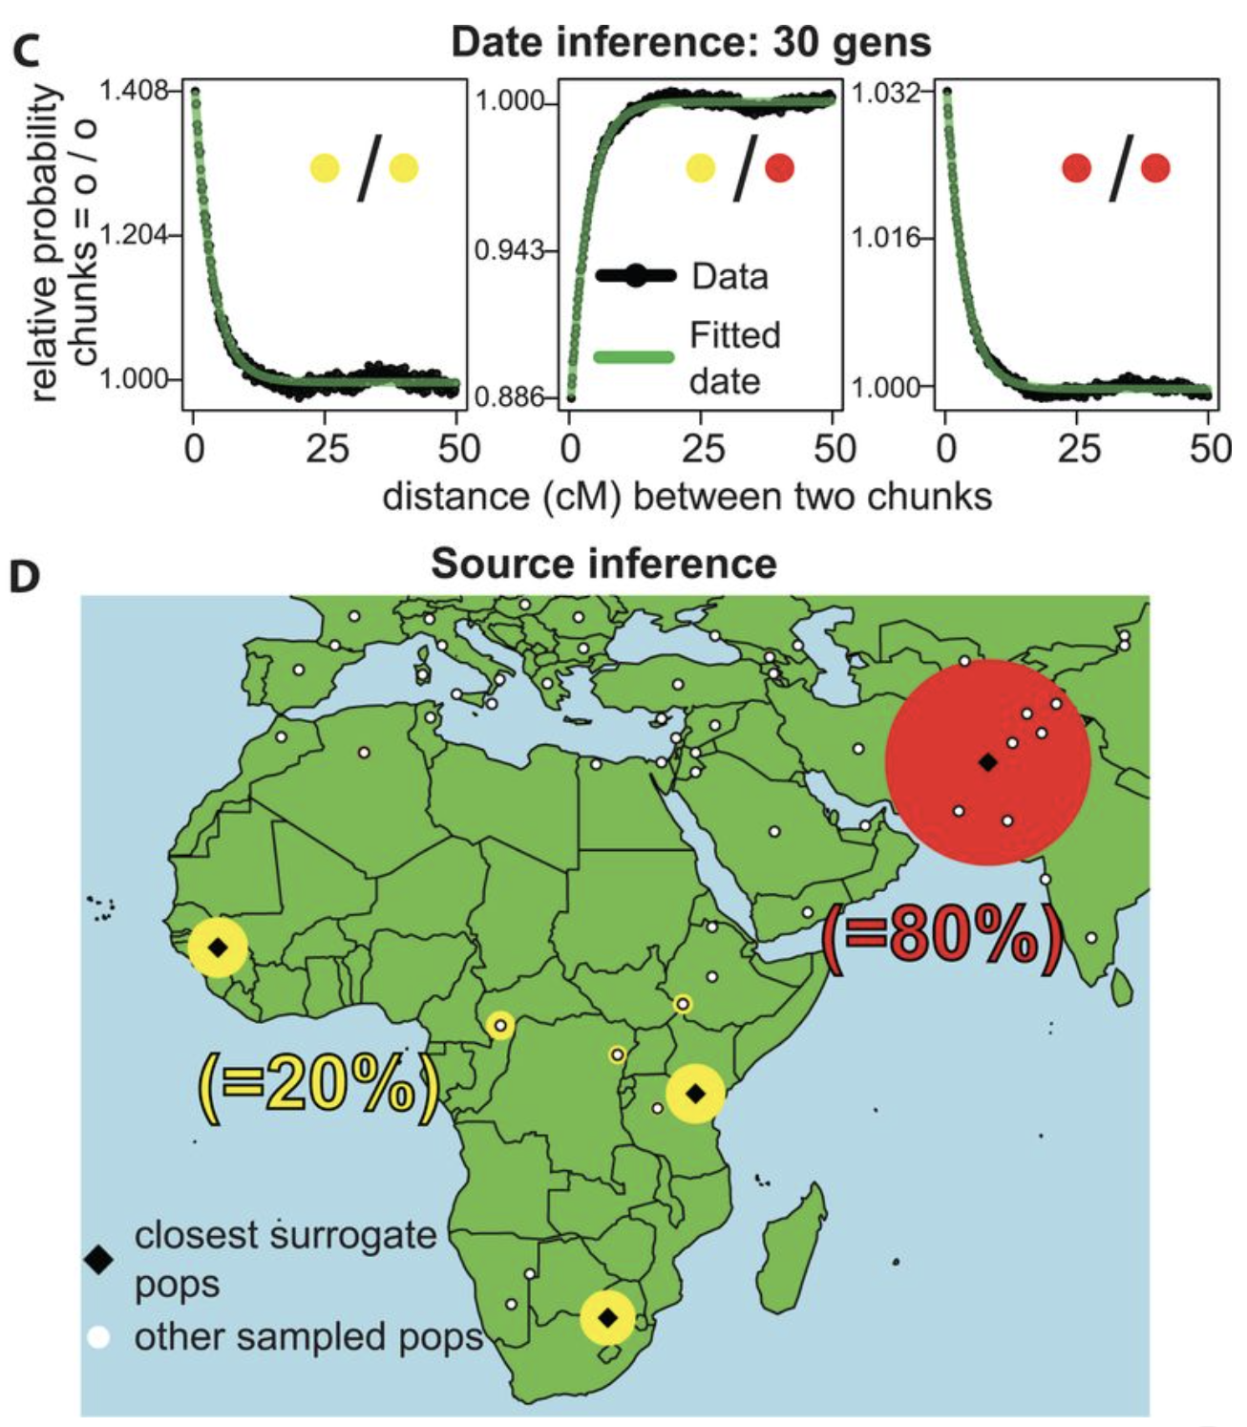
Inferring admixture events - Globetrotter
Hellenthal et al, Science, 2014
Notes:
Inference – we’ll do this in the practical
Our model fitting narrows the donor set largely to Central-South Asia and Africa, generating a “cleaned” painting.
Coancestry curves (black line) show relative probability of jointly copying two chunks from red (Balochi; F_{ST} =0.003 with Brahui) and/or yellow (Mandenka; F_{ST} =0.009 with Yoruba) donors, at varying genetic distances. The curves closely fit an exponential decay (green line) with rate 30 generations (95% CI: 27-33). The positive slope for the Balochi – Mandenka curve (middle) implies these donors represent different admixing sources

Slide 43
Genetic mixing over the past 4000 years
93 human populations
Hellenthal et al, Science, 2014
Image credit G Hellenthal
Notes:
Work applied this to 93 human populations

Slide 44
Genetic mixing over the past 4000 years
76 confidently assigned admixtures
Hellenthal et al, Science, 2014
Image credit G Hellenthal
Notes:
76 – confidently assigned admixture

Slide 45
Genetic mixing over the past 4000 years
Hellenthal et al, Science, 2014
Image credit G Hellenthal
Notes:
Genetic signals of Mongol Empire in Eurasia
European mixing in China at the time of the silk road
Colonial migrations in the Americas
Admixture is super common.
Many of these events correlated with known history – but also potential for DNA and these kind of approaches to inform you on events in the deeper past or for which there is no written record
aDNA - ancient admixing sources

Slide 46
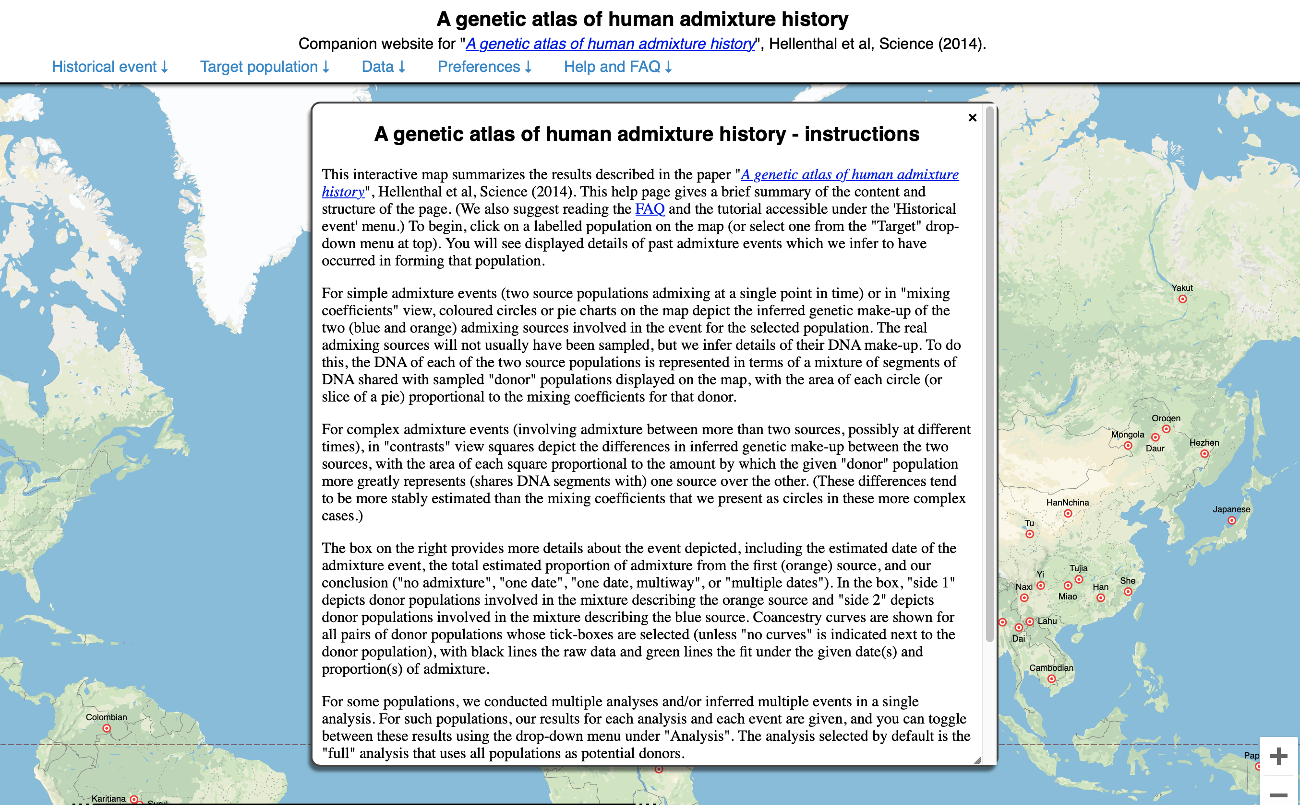
http://admixturemap.paintmychromosomes.com

Slide 47
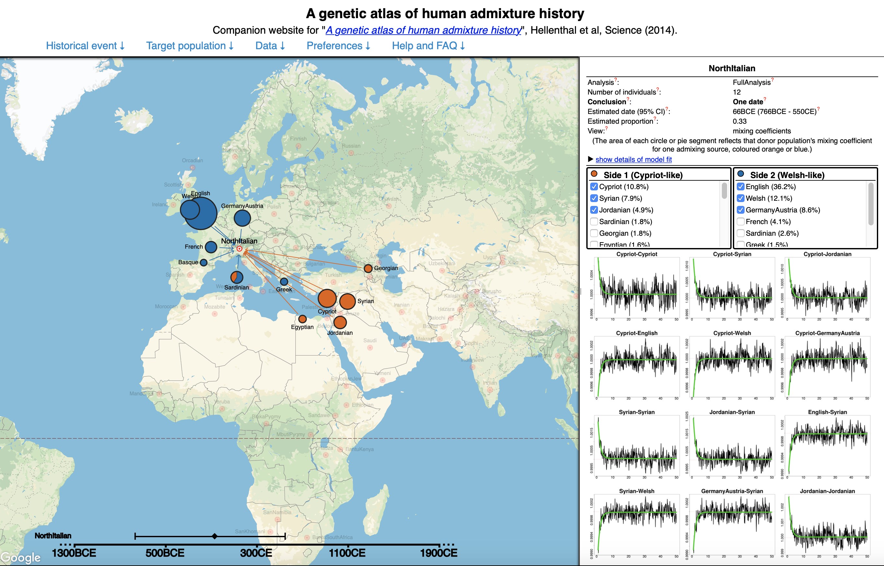
Notes:
Example

Slide 48
Summary
Many programs for inferring and determining population structure – central to understanding demographic history
PCA and model-based clustering make use of unlinked allele frequencies. Fast and tractable, though interpretation can be challenging.
Haplotype-based methods – a toolkit for exploring local ancestry, LD, recombination and subsequently fine-scale patterns of population structure at different scales.
Chromopainter and fineSTRUCTURE as tools for resolving subtle differences between populations.
Admixture LD can be utilized together with chromosome painting to identify when admixture has occurred, its sources and its timings.
Such analyses are highlighting that admixture is common place within human populations over the past 4000 years.
Notes:
Identifiying coalescence events between haplotypic blocks – Leo wil talk about this later

Slide 49
Suggested Reading/Software
Overview of methods in PopGen:
Schraiber & Akey. Methods and models for unravelling
human evolutionary history. Nature Reviews Genetics. (2015) 6(12):727-40.
How not to overinterpret ADMIXTURE plots:
Lawson, van Dorp & Falush. A tutorial on how not to over-interpret STRUCTURE and ADMIXTURE bar plots. Nature Communications. (2018) 9,3258.
Chromopainter/fineSTRUCTURE:
Lawson, Hellenthal, Myers & Falush. Inference of Population Structure using Dense Haplotype Data. PLoS Genetics. (2012) 8(1): e1002453.
https://people.maths.bris.ac.uk/~madjl/finestructure-old/chromopainter_info.html
Fine-scale structure of the British Isles:
Lesie, Winney & Hellenthal et al. The fine-scale genetic structure of the British population. Nature. (201) 519,309-314.
GLOBETROTTER:
Hellenthal et al. A genetic atlas of human admixture history. Science. 14; 343(6712):747-751.
https://people.maths.bris.ac.uk/~madjl/finestructure/globetrotter.html
Thank you to Garrett Hellenthal!

